Slide 1
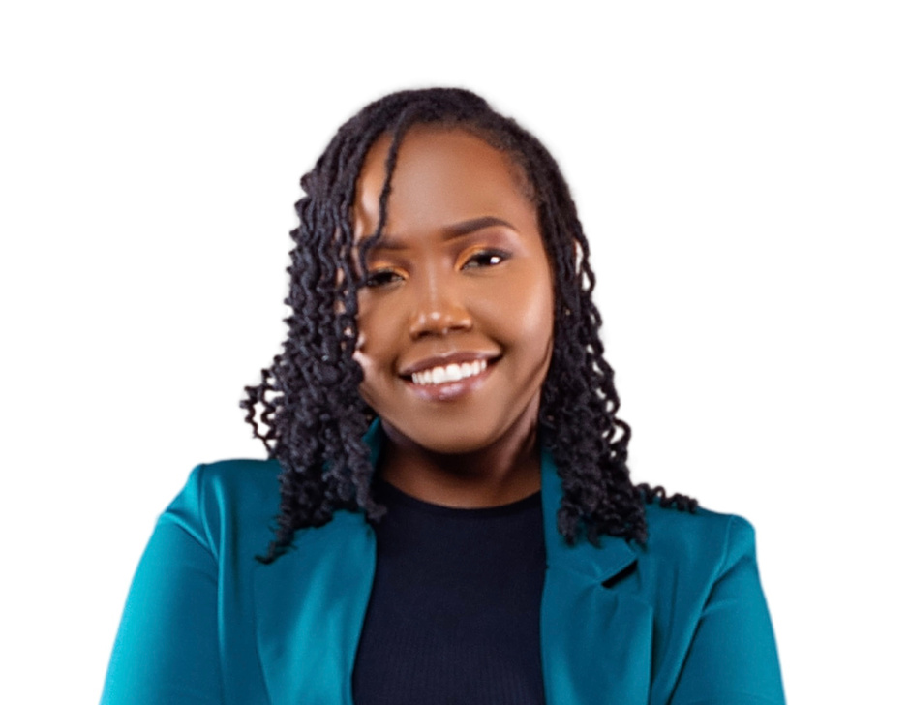

Lona Akinyi
Operations & Administrative Assistant
LinkedIn

Slide 2
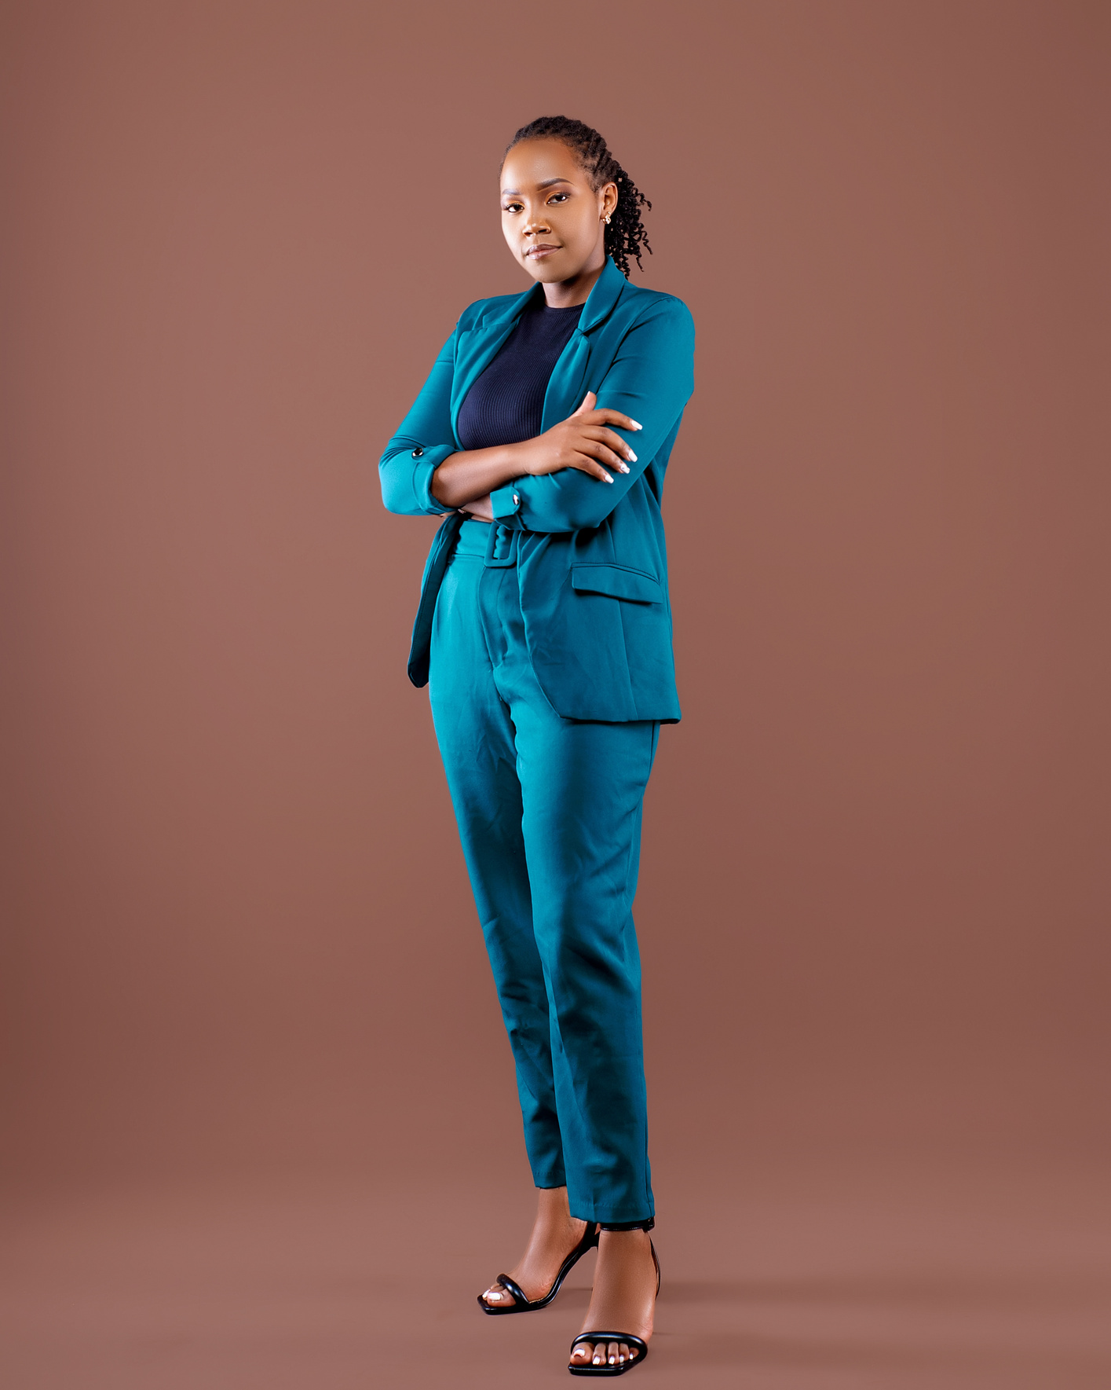
Introduction
About me
I am a highly motivated Administrative Executive Assistant and Virtual Assistant Specialist with over 3 years of experience optimizing efficiency, productivity, and service quality in diverse environments. With a proactive attitude and a passion for delivering exceptional results, I excel in customer service, conflict resolution, and building strong relationships. My expertise lies in the travel and administrative sectors, where I leverage advanced organizational skills, technical proficiency, and business acumen to achieve objectives and foster positive engagement.

Slide 3
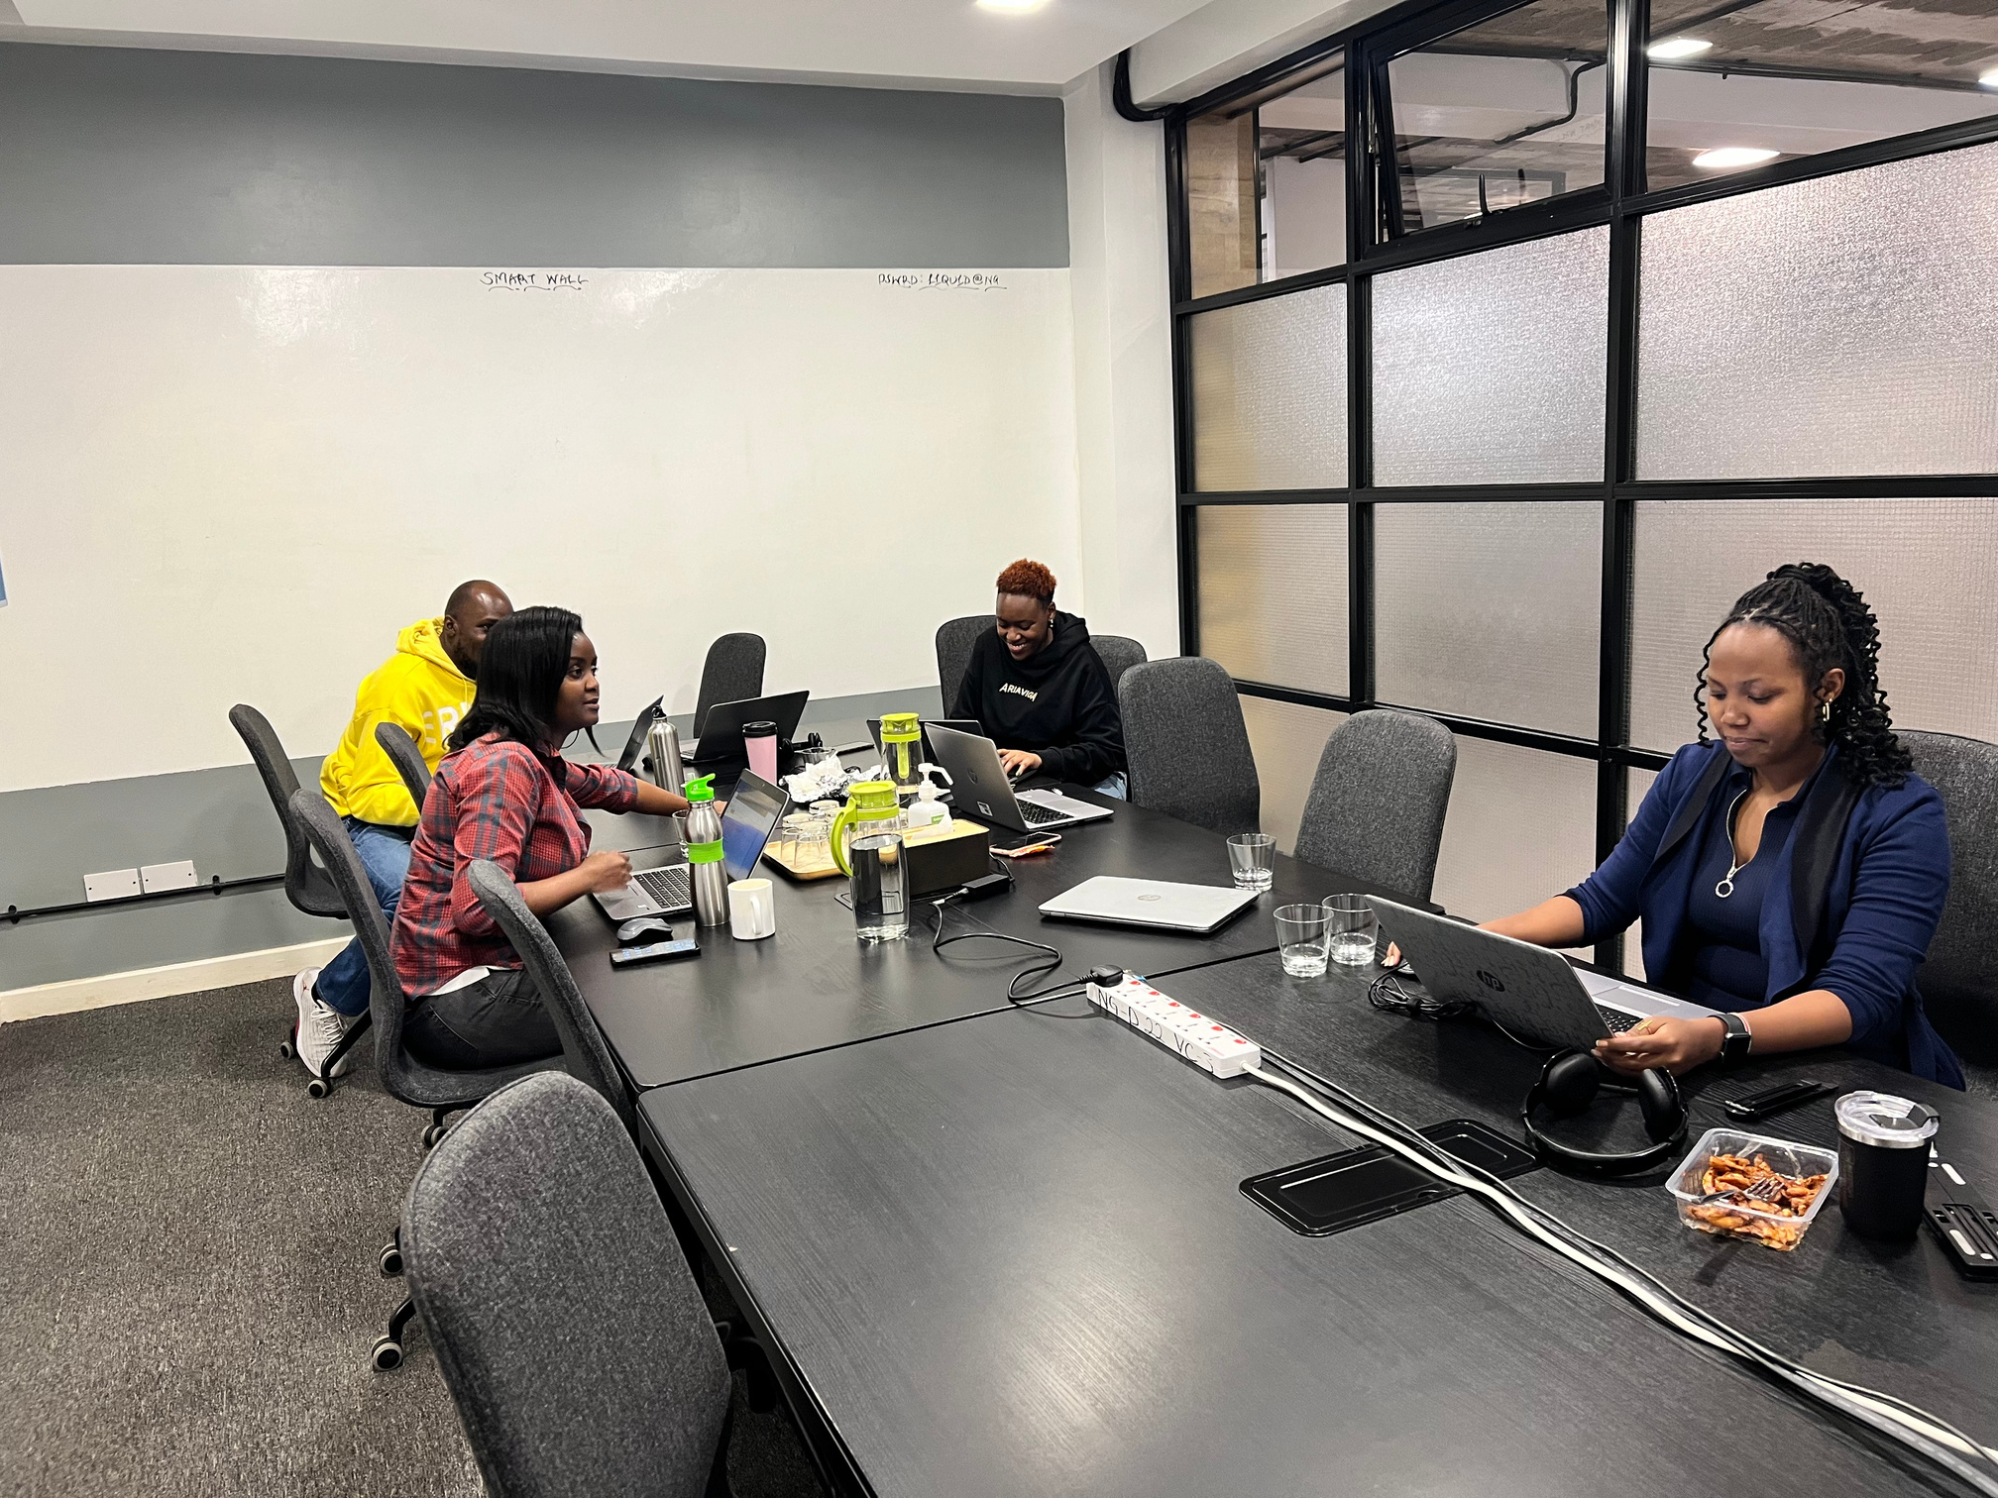
Personal Projects
Executive Assistant to:
Both CEO & President at LeagueApps
CEO at Cloud Range Cyber
Back up Executive Assistant to:
CEO at Denny Civic Solutions
CEO at RacquetDesk
Travel Consultant at:
Kings Consolidated Travel
Muce Travel & Tours
Prime Flight Travel & Tours

Slide 4
Core Competencies
Administrative Expertise
Travel and Hospitality
Technology Proficiency
Expert in Flight Bookings, Reissues, and Itinerary Planning
Skilled in Negotiating Vendor Rates and Managing Travel Plans
Proficiency in Amadeus & Galileo GDS Systems and online platf
Tools:
Microsoft Office Suite
Google Workspace
Notion
Canva | Adobe
Slack | Zoom | Google Chat
Expensify
Navan
Sejda
DocuSign
Audio Transcription & Data Analysis
Executive Calendar Management & Scheduling
CRM Management & Data Entry
Expense Tracking & Travel Management
Board Deck Presentations
Task Management
Custom one-off tasks

Slide 5
Work Experience
2017
2021
2023
✈️ Reservations Manager
Delivered personalized travel experiences tailored to clients' budgets and preferences.
Enhanced client loyalty by resolving issues and anticipating their needs.
Promptly handled an average of 80 customer inquiries and complaints per day with a 96% customer satisfaction rate.
Maintained a knowledge base of the evolving product offerings and improved
customer retention by 9% by proactively recommending new products to new customers.
Actively worked to display a courteous and empathetic attitude to customers, resulting in a QA score of 100.
📊 Data & Audio Specialist (Independent Contractor)
Ensured precision in audio transcription with adaptability to diverse accents.
Analyzed and structured unorganized data for optimal utility.
Developed long-term client relationships through consistent high-quality work
Communicating effectively with clients or project managers to clarify requirements, address concerns, and ensure client satisfaction.
Identifying and flagging any ambiguous or unclear content for further review or clarification.
• Maintaining records and documentation of completed content and related project information.
🚀 Executive Assistant to the President & CEO at LeagueApps, CEO & Founder at CloudRange Cyber
Optimized their schedule and calendar, increasing productivity by 56% through effective time management and prioritization of key tasks.
Created professional slide presentations for strategic meetings, enhancing clarity and decision-making, contributing to a 25% improvement in meeting outcomes.
Managed inbox operations, reducing response times by 35% and ensuring timely communication with stakeholders.

Slide 6

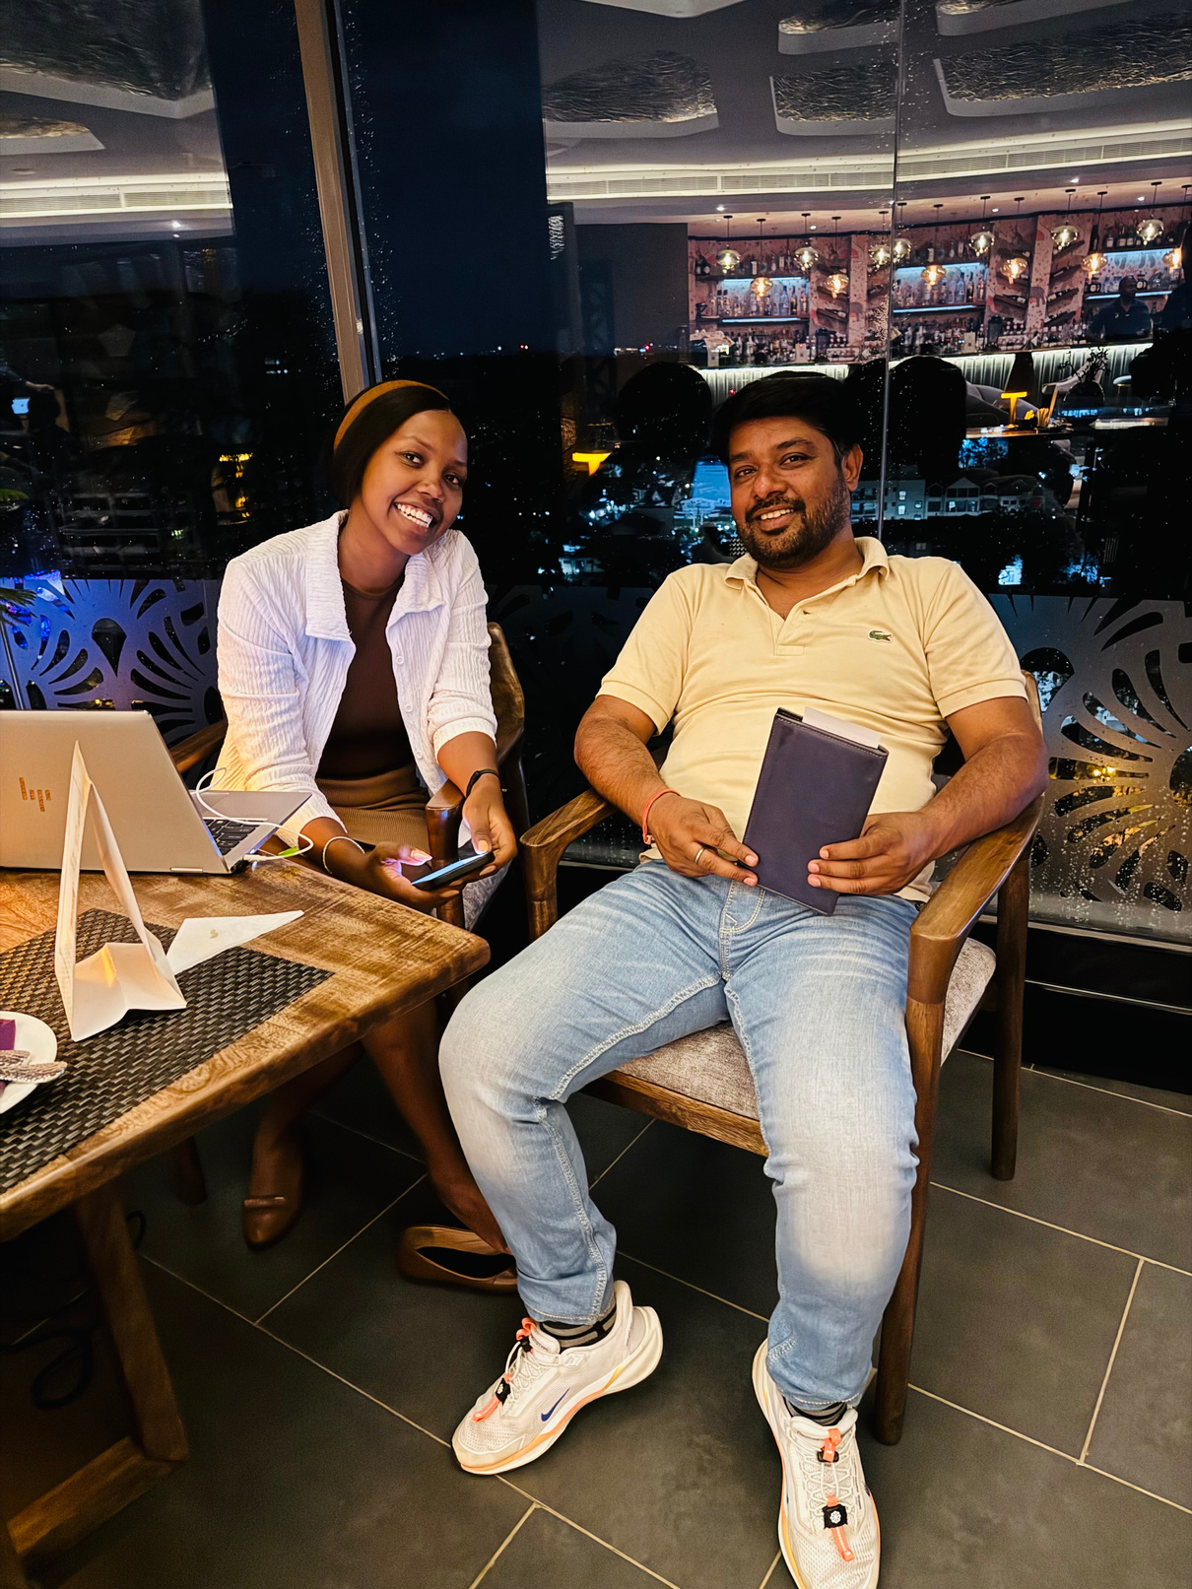
🌍 Portfolio Showcase
📌 Project Highlights
Designed complex travel itineraries for high-profile clients.
Transcribed audio for 1,000+ minutes of content with 98% accuracy.
Managed multi-million shilling travel budgets for corporate and individual clients.
📂 Client Testimonials
"Lona’s efficiency and attention to detail are unmatched! She made my travel seamless and stress-free.”
– Zahra Mohamed

Slide 7


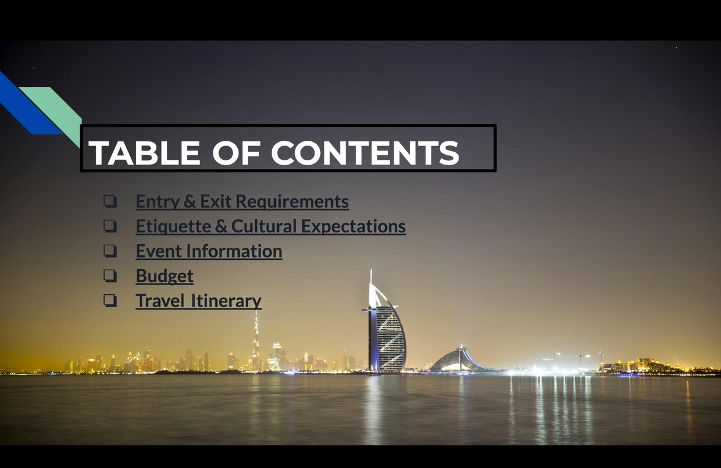
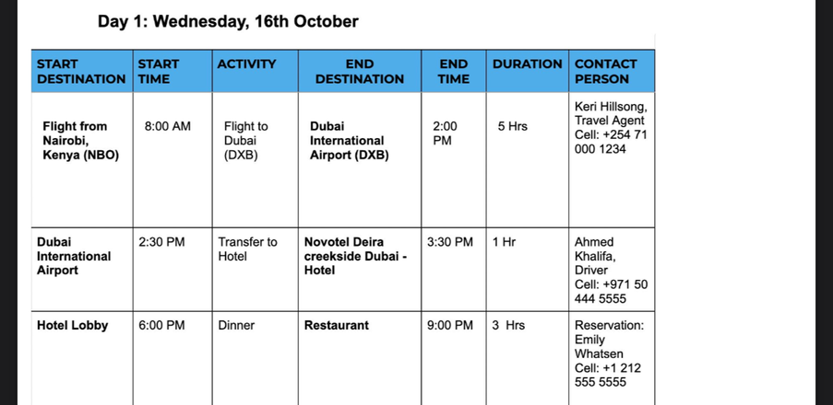


TRAVEL MANAGEMENT
TRAVEL PACK
CLICK ON THE LINK
DUBAI TRAVEL PACK

Slide 8
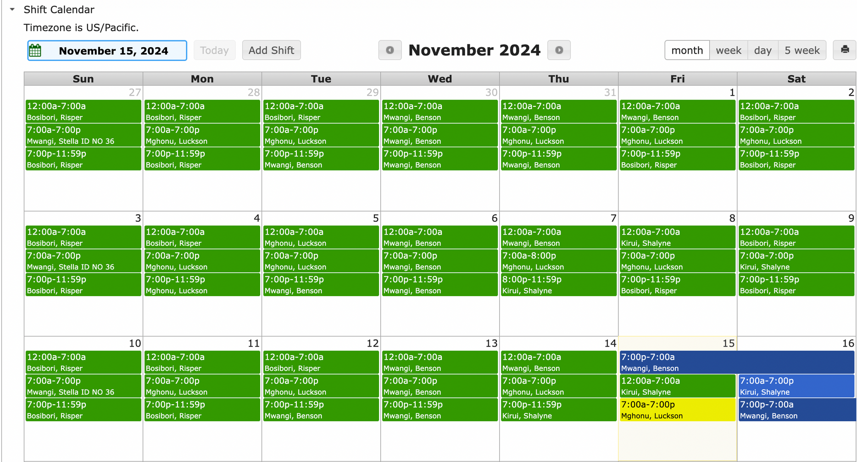
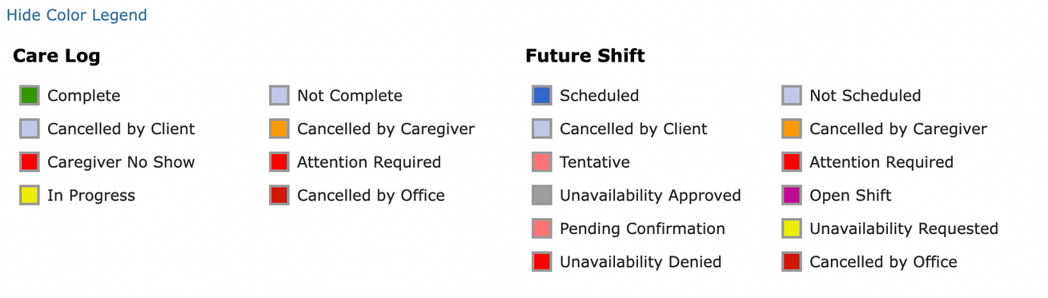

CALENDAR MANAGEMENT

Slide 9
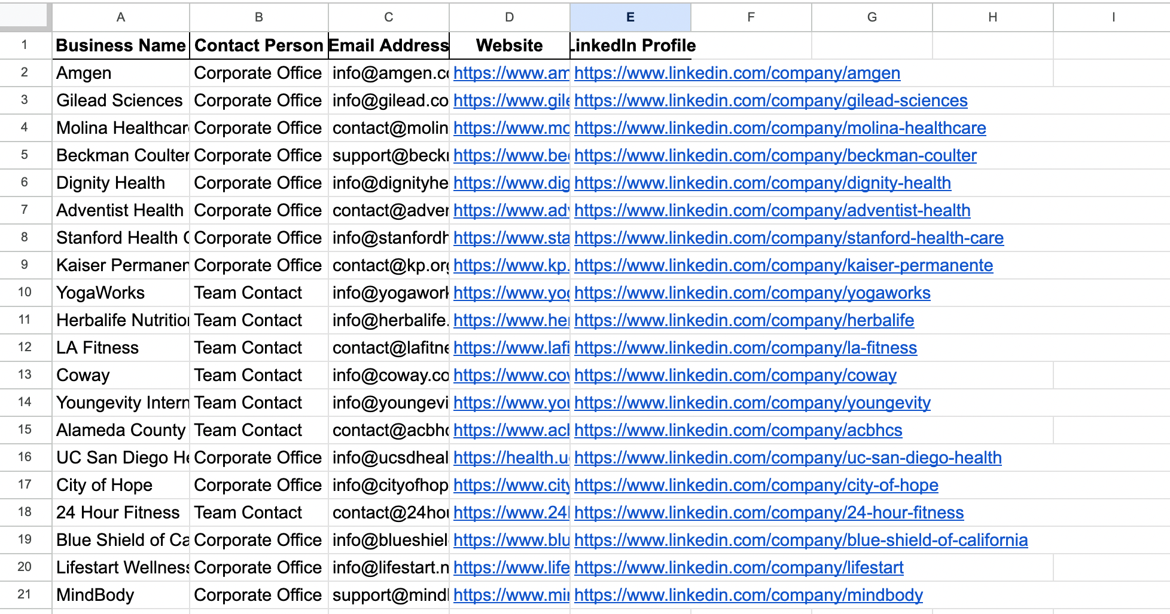
LEAD GENERATION

Slide 10
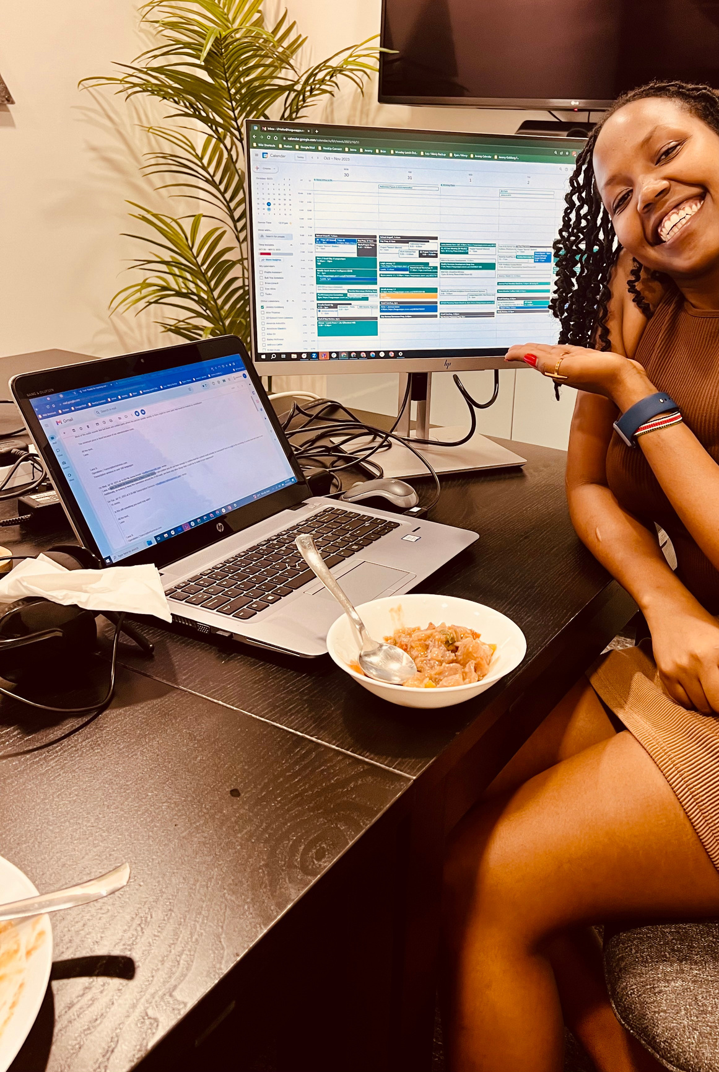
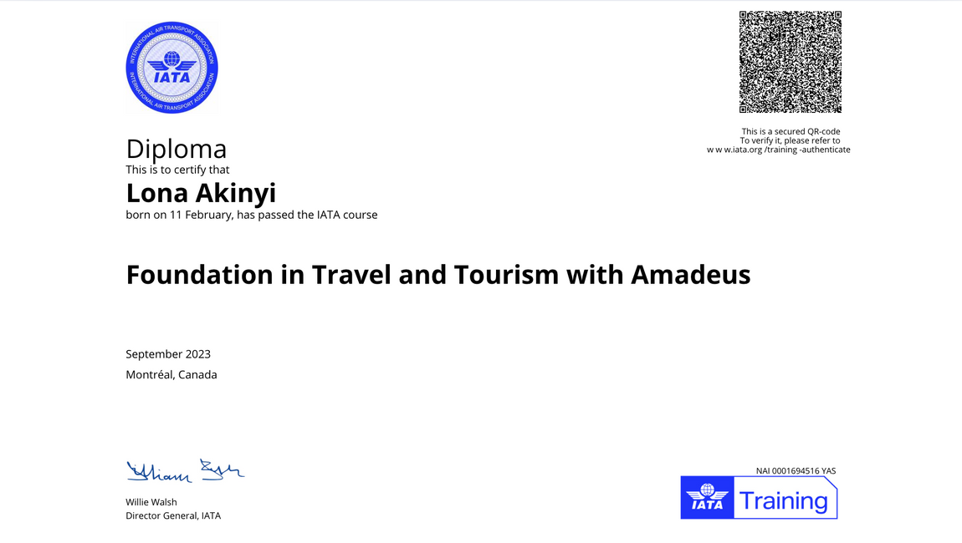
Educational Background
Advanced Training in Executive Admin Assistance
2022 - 2024
Diploma in Travel & Tourism
2022 - 2023

Slide 11
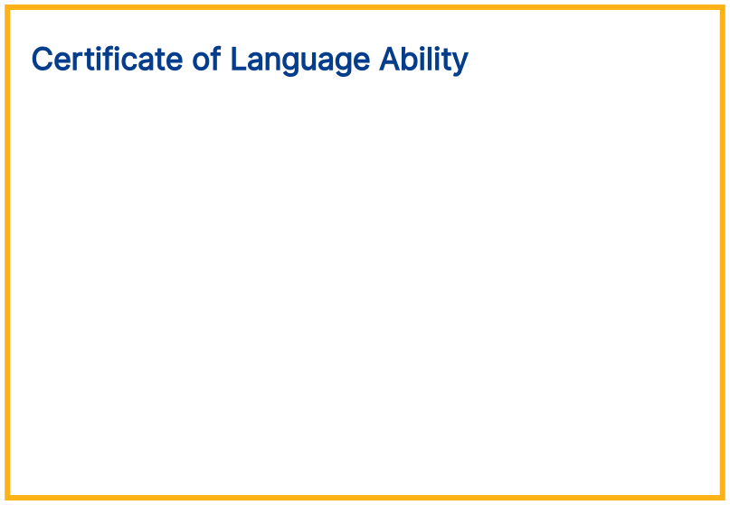




Certificate of Language Ability
Lona Akinyi
Scores
English Speaking
Individuals at this level can participate in conversations about familiar topics that go beyond everyday life, including some academic and professional topics. They can handle a familiar situation with an unexpected complication. They can talk in detail and in an organized way about events and experiences in various time frames.
7.8
TrueNorth
B2
CEFR
Judson Hart Assessment Excellence Team Presented on: 22 February 2024
Learn more about your score at app.emmersion.ai

Slide 12
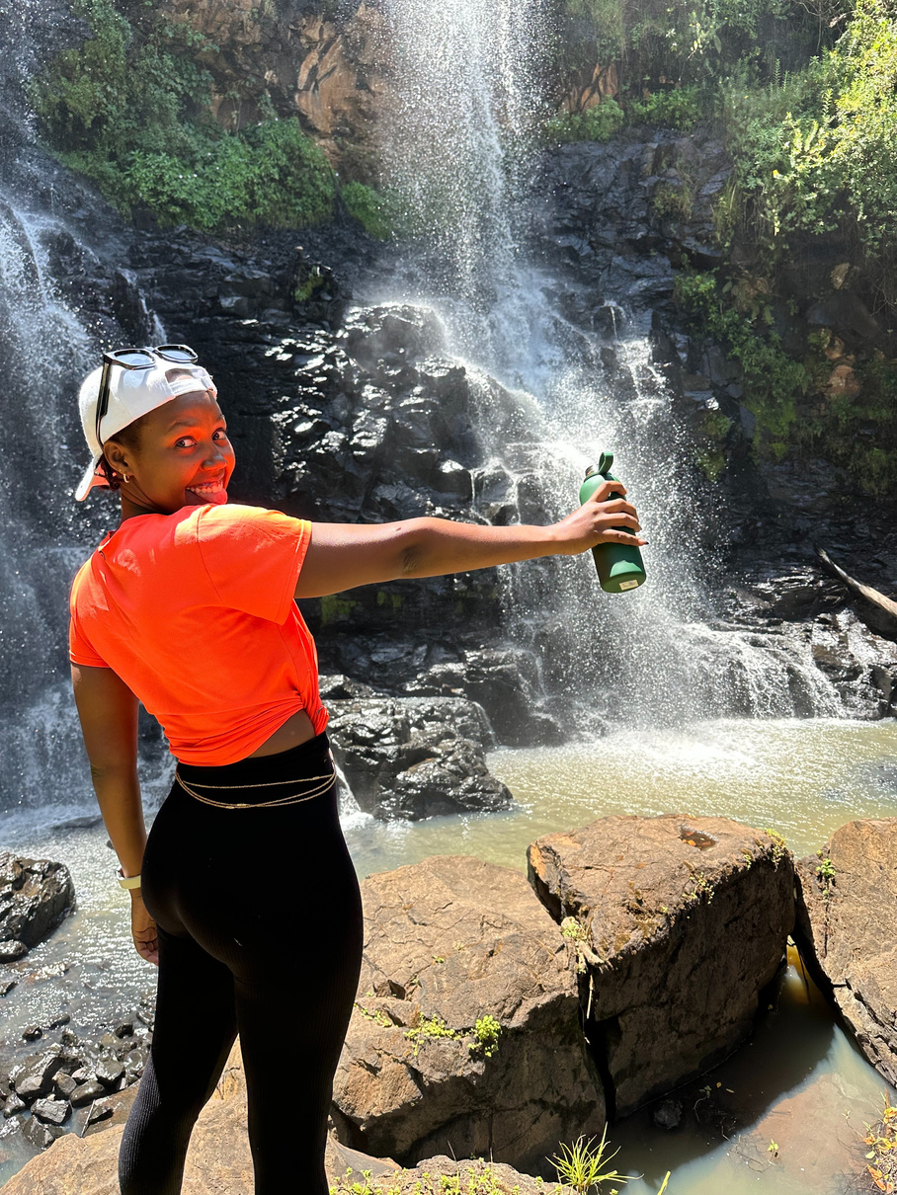
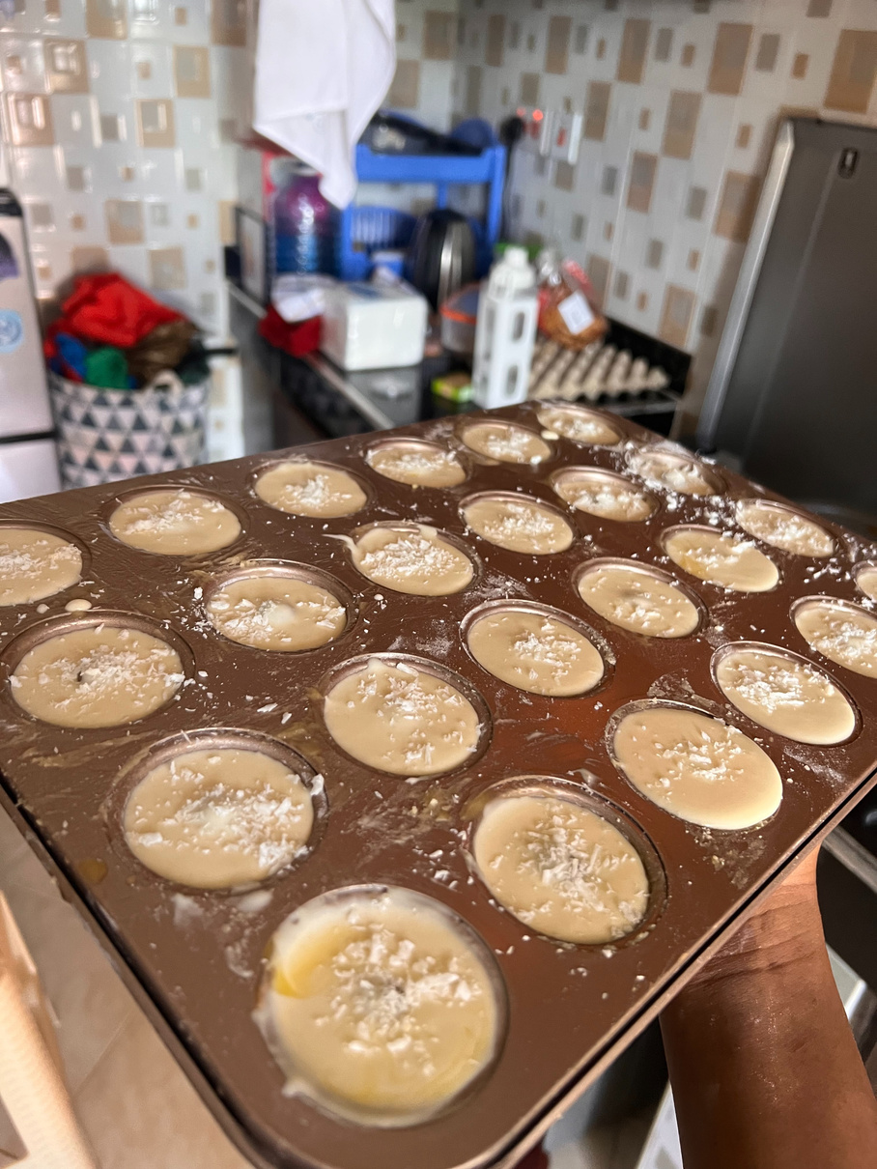
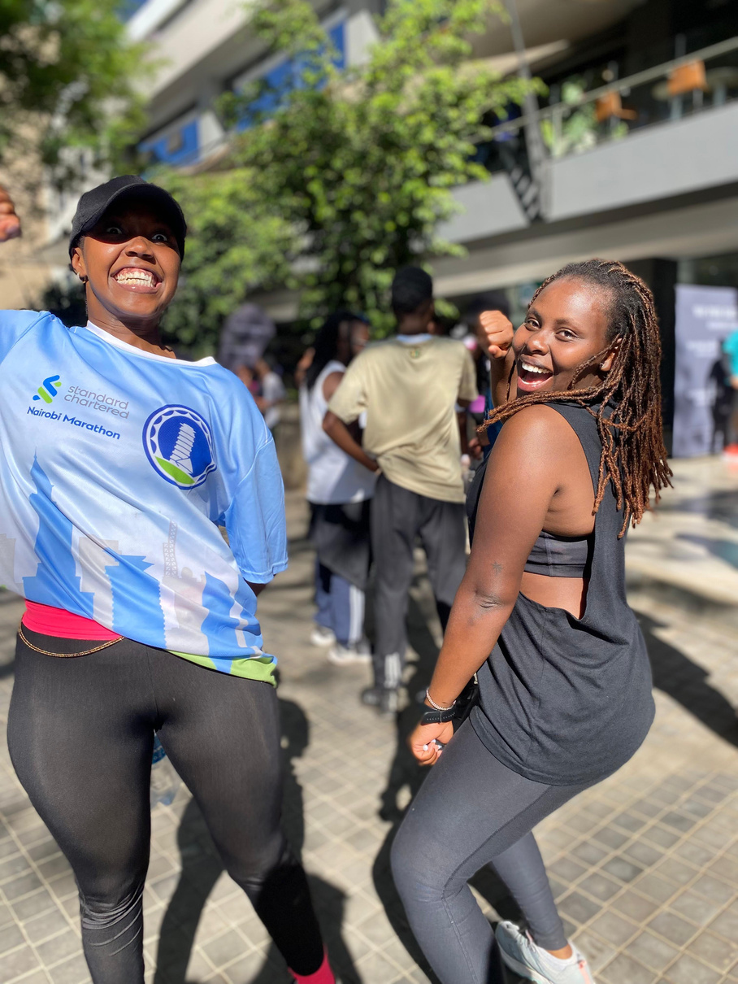
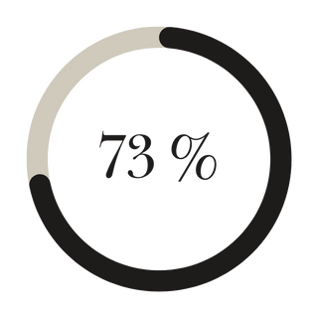
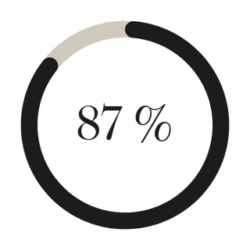
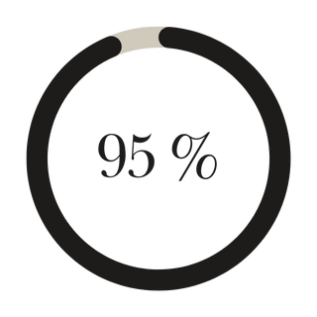
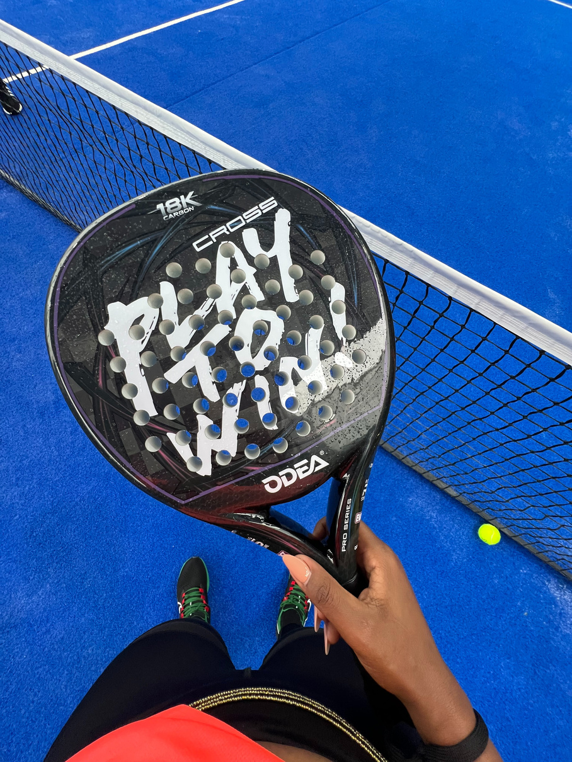
🎨 Personal Skills
When I’m not crafting exceptional experiences, you’ll find me:
Traveling to scenic destinations
Enrolled in a marathon
Baking delicious treats
Dancing to energize my spirit
Taking amazing pictures of plants and small people
Sports
Photography
Social Skills

Slide 13
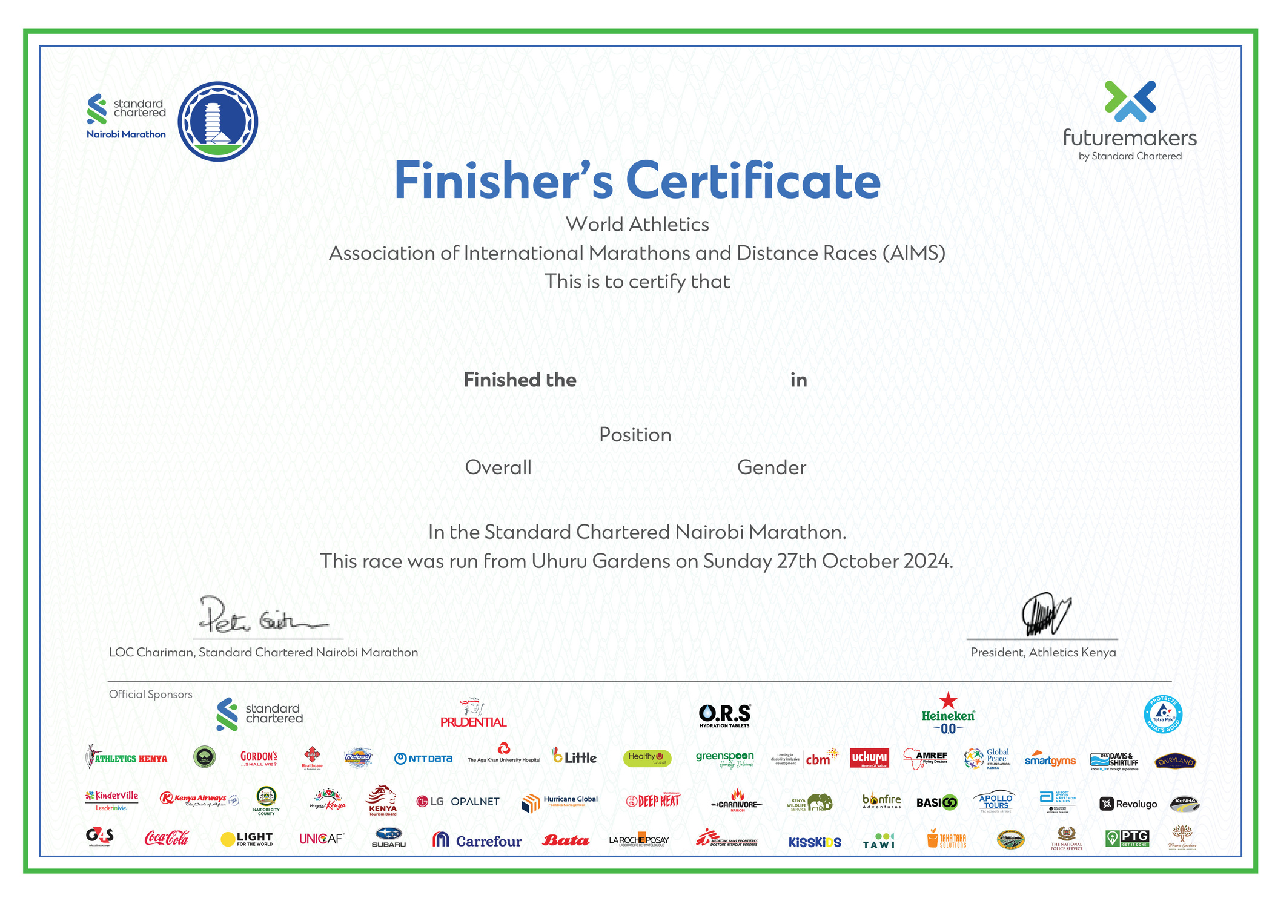
Lona Akinyi
21.097 km
2:31:08
2170
359

Slide 14
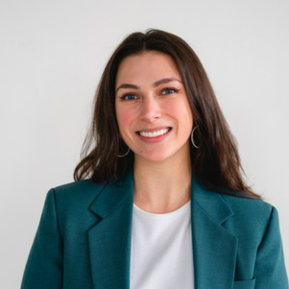

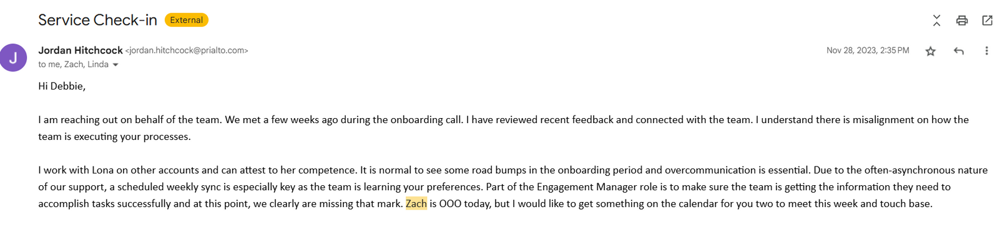
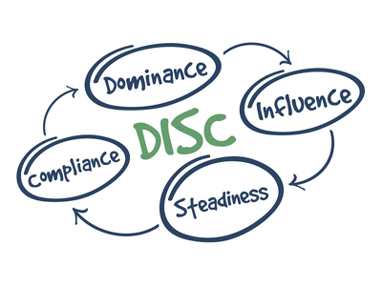
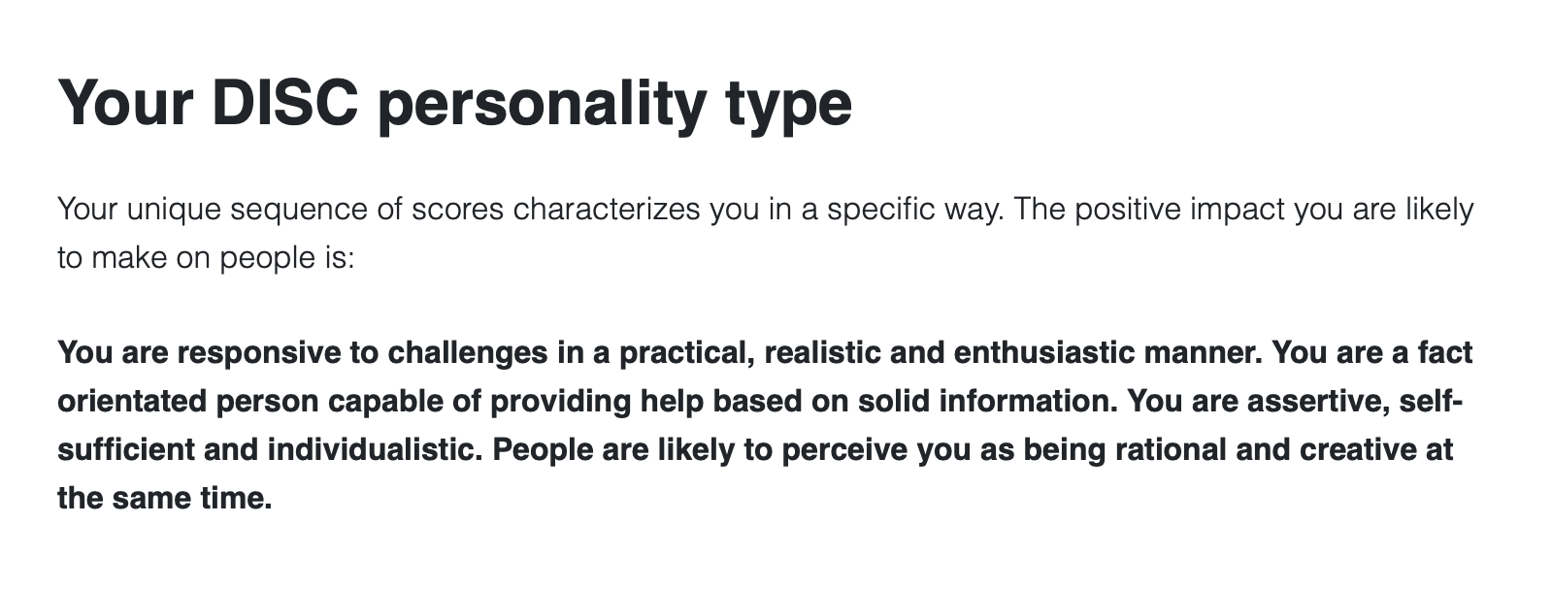
Testimonials
Jordan Hitchcock
Global Engagement Manager

Slide 15

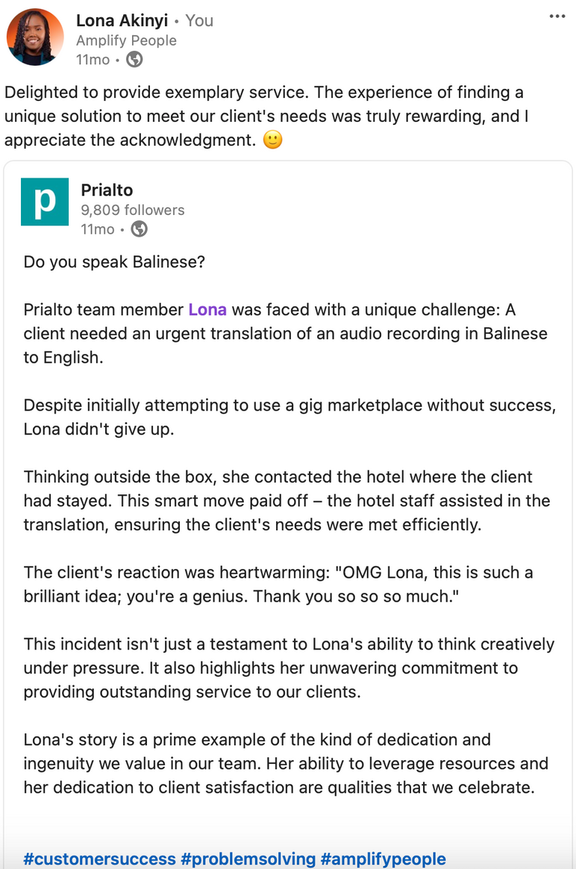
Testimonials - Prialto HQ

Slide 16
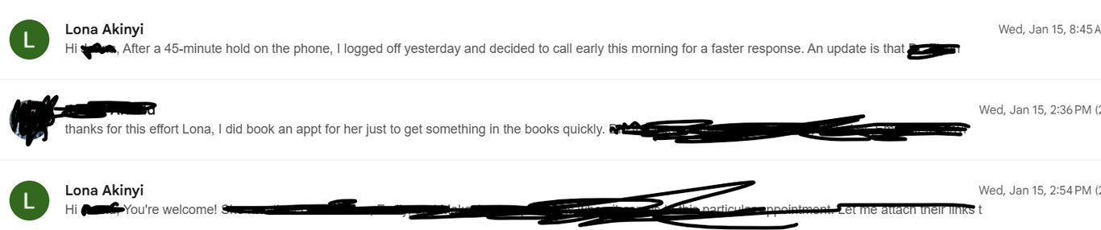
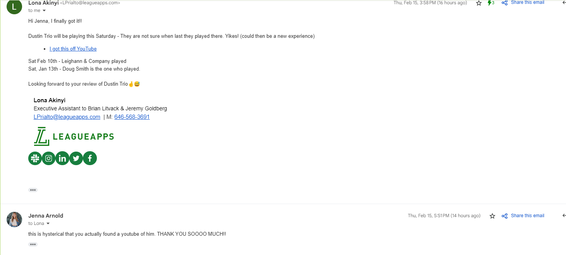
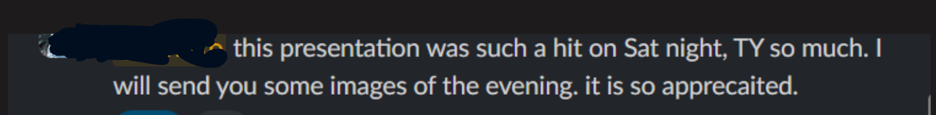

Slide 17






Let's Work Together
+254 716 007 616
LinkedIn
lona.akinyi26.com
123 Anywhere St - Remotely - Worldwide

